Slide 1
Get me out of here: Determining optimal policies
Seminar: Cyber-Physical systems
Advisor: Christian Pek
Notes:
Hi, my name is Marcel
My topic is
Get me out of here:
Determining optimal policies

Slide 2
Outline
Background and Problem Statement
Fundamentals of Dynamic Programming
Solving the Dynamic Programming equations
Related work and use cases in robot motion planning
Notes:
I will now start with the Problem statement on which my topic is based
And will then go on with the fundamentals of Dynamic Programming,
Which is the mathematical method i used to tackle my problem
For that i will be introducing the necessary dynamic programming equations
And will later on come to some related work and use cases of DP in Robot motion planning

Slide 3




Background and Problem Statement
Notes:
Starting with the background
Show a problem everybody might know from childhood
Coming to problem statement
Solving it mathematical

Slide 4

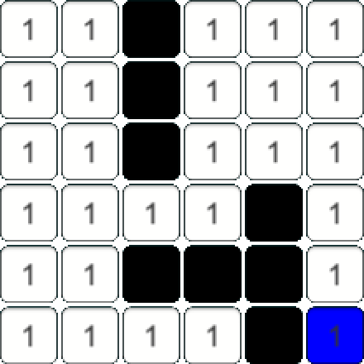




Background
Walls:
$M\left(i,j\right)=∞$
Gridmap: $M=ℕ^{n × m }$
Set of exits:
$$X_{goals}$$
Cost to step on tile:
$$M\left(i,j\right)∈ℕ$$
Notes:
Game Labyrinth
Field build up by fixed & moving tiles
Walls, passages and treasures on the tiles
Goal is to find ways through maze & collect treasures
To reach goal -> Way to calculate shortest paths
Dynamic Programming is one way to approach
Define a gridmap $M=ℕ^{n×m}$ as seen right
Value on tile == cost to step on it ~= distance
$M\left(i,j\right)=∞$ represent walls (black)
Set of goals player wants to reach

Slide 5
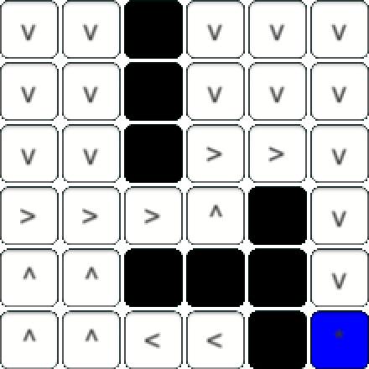




Problem Statement
Determine optimal policies
$$ℕ^{n×m}$$
$$→$$
$A∈\{$v$,<,>,^\}$
$$→$$
Notes:
Goal of paper is to determine optimal policies
Therefor we want to find a function assigning best action to every position
$P=ℕ^{n×m}→A$
Therefore calculate value of all tiles, which equals shortest path length
Coming from left normal view
Determine actions
Show some examples…

Slide 6
Fundamentals of Dynamic Programming
Notes:
Continuing with the fundamentals used for approach
What is Dynamic Programming
The principle of Optimality which is important for DP
Fundamental approach for deriving mathematical formulations for this type of problem
Actual mathematical formulation
Which characteristics a problem solvable by DP

Slide 7
What is Dynamic Programming
Method used in mathematical optimization
Transforms complex problems into sequences of simpler subproblems
General framework for a broad variety of problems
Base concept: Sequential decision making problem
Notes:
DP method in mathematical optimization
Always under certain objective
Minimize path length
Maximize profit…
Transforms complex problems into sequence of simpler subp.
Each subproblem solved once & solution stored
If reoccuring, use cached result
Safe computation time
Optimal solution by combing solutions for subproblems
General framework for many problem types
Planning of industrial Production lines
Scheduling patients ad medical clinic
Long term investment programs
Robot motion planning
Underlying sequence of decisions in finite number of stages
Timesteps, Moves…

Slide 8
The principle of optimality
A policy is a sequence of decisions
An optimal policy is a sequence of decisions that has the best outcome w.r.t. a predefined criterion
Notes:
For starting more precise discussion
A policy is a sequence of decisions.
An optimal policy is a sequence of decisions that has the best outcome w.r.t. a predefined criterion.
Classical approach would be, calculate all policies, and optimize the return
Richard Bellman, inventor of DP saw
No need to know whole sequence
Better find a general description, function that returns best decision at any time
Only depending on current state

Slide 9

Mathematical formulation
$p=\left(p_{1},p_{2}, …,p_{M}\right)∈X$
$U=\left\{T_{k}\right\}; p∈X⇒T_{K}\left(p\right)∈X, ∀k$
$P=\left(T_{1}, T_{2}, …, T_{N}\right)$
$p_{1}=T_{1}\left(p\right)$
$p_{2}=T_{2}\left(p_{1}\right)$
$⋮$
$p_{N}=T_{N}(p_{N−1})$
$h_{N}\left(p\right)=\max_{p}{R(p_{N})}$
$h_{N}\left(p\right)=\max_{k}{h_{N−1}(T_{K}\left(p\right))}, N=2,3,…$
Notes:
How do the functional equations needed for DP
Process of system is describet at any time by M-dimensional vector:
$p=\left(p_{1},p_{2}, …,p_{M}\right)∈X$
Set of transformations
$U=\left\{T_{k}\right\};$
With property: $p∈X⇒T_{K}\left(p\right)∈X, ∀k$
Now having a N-stage process, a policy consists of a selection of N transformations:
$P=\left(T_{1}, T_{2}, …, T_{N}\right)$
$p_{1}=T_{1}\left(p\right)$
$p_{2}=T_{2}\left(p_{1}\right)$
$⋮$
$p_{N}=T_{N}(p_{N−1})$
What the goal is now is to maximize the return of the final stage
A return gives a scalar value for the final stage
For finding the optimal policy, we want to maximize this return
$h_{N}\left(p\right)=\max_{p}{R(p_{N})}$
Now using the principle of optimality
1. decision -> Transformation $T_{k}$
Result $T_{k}(p)$ -> left (N-1) stages -> Return $h_{\left(N−1\right)}\left(T_{k}\left(p\right)\right)$
To maximize the value, we want t want the maximum value of this equation
$h_{N}\left(p\right)=\max_{k}{h_{N−1}(T_{K}\left(p\right))}, N=2,3,…$
Recursively calculating From stage N till 0
There we see, not unique

Slide 10
Characteristics of problems solvable by Dynamic Programming
Fundamentals of dynamic programming
Notes:
Staying in the fundamentals of Dynamic Programming
I will now continue with the characteristics
Problem needs to be solvable by DP
Overlapping subproblems
Optimal substructure

Slide 11
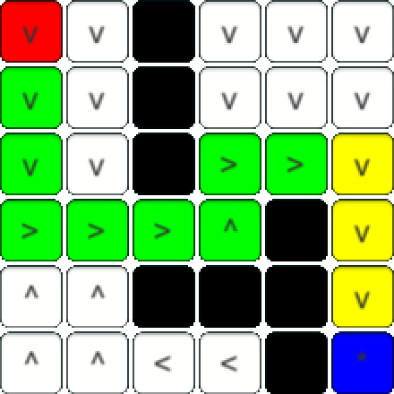
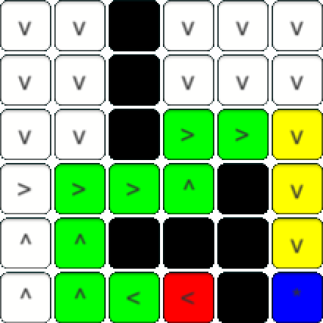
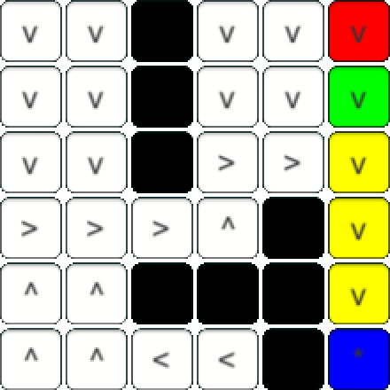
Overlapping Subproblems
Space of subproblems is small
Solutions reused many times
Recursive algorithm solves same subproblems over and over
Notes:
Overlapping subproblems means:
The space of subproblems is small
If problem is broken down into set of subproblems
Solutions to these subproblems reused
Recursive algorithm solve same subprobs over and over again
And not new subproblems
1. If calculating theoptimal policies
Yellow will always be included
2. Here again yellow included
3. Also
Yellow piece always included
Recusive algorithm will over and over calculate this piece of path

Slide 12
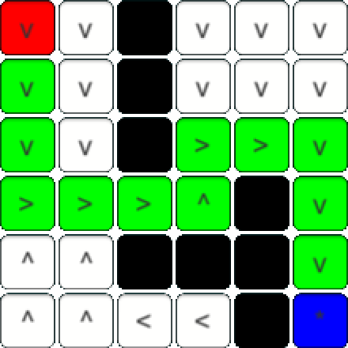
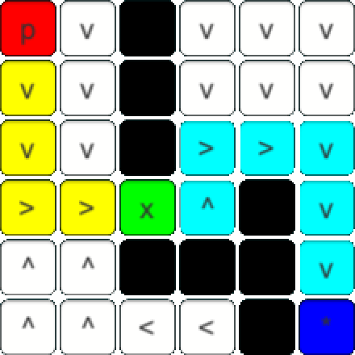
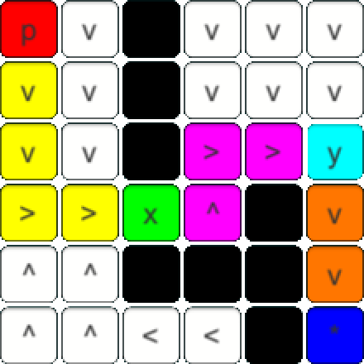
Optimal Substructure
Solution for whole problem by combination of solutions for subproblems
Notes:
A problem has optimal substructure if Solution for whole problem found by combination of solutions for subproblems
Animation:
For calculating this whole optimal policy (green)
We could have also calculated the subpaths from p->x & x->goal which have to be the shortest paths
Could again split in x->y & y->goal
Split down recursively until only one tile to next one and combine these solutions to whole solution

Slide 13
How to apply Dynamic Programming in Computer Science
Fundamentals of dynamic programming
Notes:
Finished with the characteristics
Now come to how to actually apply Dynamic Programming
To solve Problems in Computer Science

Slide 14
Memoization
Break problem down into set of subproblems
Store results in a table
Use cached result if subproblem reoccures
Notes:
Important Concept for DP is memozation
As result of overlapping subproblems
Problem can be broken down subproblems
For each subproblem calculate solution
Results can be stored in a table, so solution found pnly once
If problem is reoccuring, use the cached result
This saves computation time for the tradeoff for memory usage
But in times of rapidly increasing memory sizes
And shrinking cost
Drawoff negligible

Slide 15

Bellman equation
Find a connection between one step and the next one
$V\left(x\right)=\max_{a∈Γ(x)}{ \{Payoff\left(x,a\right)+V(Transformation(x,a))\}}$
Richard Bellman introduced backwards induction
Begin at step $N→$ Derive $\left(N−1\right)→…→$ Initial step
Notes:
We want to find a relation between the value of one step and it‘s predecessing step
This connection is called the Bellman equation
$V\left(x\right)=\max_{a∈Γ(x)}{ \{F\left(x,a\right)+V(T(x,a))\}}$
Current value based on Payoff F and the Value of the next best state
From this equation Bellman introduced an approach called backwards induction
Calculate at first optimal policy at timestep N
Calculate previous step by optimizing value of future step
Apply this recursively to come to step 0 and have calculated first period decision rule
Which explicitly is based on all futere decisions being made optimally

Slide 16
Solving the Dynamic Programming equations
Notes:
After now having cleared the fundamentals of DP
And have stated the Mathematical functions
Now we want to solve the DP equations for the maze problem

Slide 17

Finding the value function
Goal is to find value function $v\left(i,j\right)∈ℕ$
Cost function $c\left(i,j\right)=\left\{\begin{aligned}∞, if \left(i,j\right)∉M \\ M\left(i,j\right) else\end{aligned}\right.$
Trivial cases $v\left(i,j\right)=\left\{\begin{aligned}∞, if c\left(i,j\right)=∞ \\ 0, if \left(i,j\right)∈X_{goal}\end{aligned}\right.$
Notes:
Initial task was the maze defined by the gripmap containing walls
Find therefore optimal policies
This is equal to finding the value function v(i,j) for each tile from what the best action can be derived
Define the value as the length of the shortest path to a goal
I define at first the cost function which is
eigther infty if looking at tile not in maze
Or the value in M(i,j), being also infty if wall
First the trivial cases for the value are
Infty, if the cost is infty == out of maze or wall
Length of shortest path infinite cause never reaching goal
Or 0 i already on goal tile
Clear cause length from one position to itself 0

Slide 18

Finding the value function
Backwards iteration: $(N, N−1,…,0)$
Store results in memoization table $V=ℕ^{n×m}$
$\left.\begin{aligned}v\left(i−1,j\right) (left) \\ v\left(i+1,j\right) (right) \\ v\left(i,j−1\right) (up) \\ v\left(i,j+1\right) (down)\end{aligned}\right\} = v\left(i,j\right)+c(i,j)$
Notes:
Using backwards iteration we want to find the value function
Their result is getting stored in the matrix V
Therefore i use the previous stated backwards iteration
I‘ve written a tool that directly uses this approach
Show finalcandidate.exe
What i‘ve shown can be expressed by this equations
Which results in the value grid on the right

Slide 19



Finding the value function
Stage $N$
$v\left(3,4\right)=0$
Stage $N−1$
$v\left(3,3\right)=v\left(3,4\right)+c\left(3,4\right)=0+1=1$
$v\left(3,3\right)=v\left(3,4\right)+c\left(3,4\right)=0+1=1$
$v\left(3,3\right)=v\left(3,4\right)+c\left(3,4\right)=0+1=1$
$v\left(3,3\right)=v\left(3,4\right)+c\left(3,4\right)=0+1=1$
Stage $N−2$ (exemplary)
$v\left(2,3\right)=v\left(2,4\right)+c\left(2,4\right)=1+1=2$
$v\left(3,4\right)=v\left(2,4\right)+c\left(2,4\right)=1+1=2$
$v\left(2,5\right)=v\left(2,4\right)+c\left(2,4\right)=1+1=2$
$v(1,4)=v\left(2,4\right)+c\left(2,4\right)=1+1=2$

Slide 20

Recursive value function
$v\left(i,j\right)= \left\{\begin{aligned}∞, if c\left(i,j\right)=∞ \\ 0, if \left(i,j\right)∈X_{goal} \\ \min_{(x,y)}{\{v\left(x,y\right)+c(x,y)\}} else\end{aligned}\right.$
With $\left(x,y\right)∈\{\left(i+1,j\right),\left(i−1,j\right),\left(i,j+1\right),\left(i,j−1\right)\}$
Notes:
So when defining it recursive we have again the two trivial cases
And now the non trivial case resulting from the previous calculated value grid
The value can be calculated by looking at the positions around it
For finding the shortest path we always follow the biggest step in values
With that we ensure that after every decision we minimize the length of the remaining shortest path
Defined as recursive function we calculate the value as th eminimum sum of the cost and the value of the adjacent tiles
Thereof recursively spreading in the maze and returning the value if a goal or a wall is found
This solves the Bellman equation

Slide 21

Finding optimal policies
Memoization table $V$ holding the values of all tiles
Find shortest paths $⟺$ Sequence with lowest sum of values
$a\left(i,j\right)=\left\{\begin{aligned}up, if v\left(i,j−1\right)=\min_{(x,y)}{\{v\left(x,y\right)\}} \\ right, if v\left(i+1,j\right)=\min_{(x,y)}{\{v(x,y)\}} \\ down, if v\left(i,j+1\right)=\min_{(x,y)}{\{v\left(x,y\right)\}} \\ left, if v\left(i−1,j\right)=\min_{(x,y)}{\{v\left(x,y\right)\}}\end{aligned}\right.$
With $\left(x,y\right)∈\{\left(i+1,j\right),\left(i−1,j\right),\left(i,j+1\right),\left(i,j−1\right)\}$
Notes:
With the value function calculated and the results stored in the memoization table V
We can easily find the shortest paths respective the optimal policies
As seen in the value function, we always make the decision so that the remaining shortest path is minimal
So for finding the current best action, we can look at the sum of the cost of the adjacent tiles
If the sum of the upper tile is lowest of all around, we go up
Usw..
Show how calculated in finalcandidate.exe

Slide 22
Related work and use cases in robot motion planning
Notes:
So after a tough mathematical derivation
I want to show you some use cases in Robot motion planning

Slide 23
Autonomous vehicles
Cars etc. are just one type of robots
Many research in last years
Best action for every position is calculated
Also applicable for vacuum robots…
Notes:
Cars might be the most prominent example for robot motion planning
Autonomous vehicles are just one type of robots
Finding the navigation paths has been a field with many research dedicated to it
Huge advantage of dynamic programming is that the best action for every possible position can be calculated previousely
And after the precalculation step the optimal policy can easily be derived
Even if there is a unexpected obstacle like a truck preventing a lane switc
The car can just go straight and then follow the best actions from the new position
Without again calculating
As you might see this is also applicable for vacuum robots and any moving autonomous vehicles

Slide 24
Extending the 2-dimensional algorithms onto N-dimensional problems
Define a state as a node in a graph
Define the transitions between states as edges in the graph
Apply 2-dimensional algorithm onto graph to solve N-dimensional problem
But curse of dimensions
Notes:
But this cannot only be applyied onto 2-Dimensional problems
For every possible configuration of the system a single state can be defined
Set these states as a node in a Graph
Between these states there is always one transition directly describing the change of the state
Set these transformations as the edges in the graph
On the resulting graph all classic path finding algorithms can be applyied
So also Dynamic Programming
But resulting thereof is the curse of dimensions, because the number of nodes is hughely expanding with every extra dimension

Slide 25

Spacecrafts floating in $ℝ^{3}$
Approaches are made on spacecrafts
One example by LaValle is one having 3 thrusters
Underactuated system solved by Dynamic Programming
Notes:
But this didn‘t stop people from finding solutions for More dimensional problems with dynamic programming
For example are approaches made for spacecrafts floating in space
An example is brought by Steven LaValle, one of the most prominent professors in robotics
He solved the underactuated system of a spacecraft having three thrusters floating in space
Underactuated means that the number of actuators ( thrusters) is stricly less than the dimension of the problem (6 DOF)
The resulting system of equations has been solved by Dynamic Programming

Slide 26
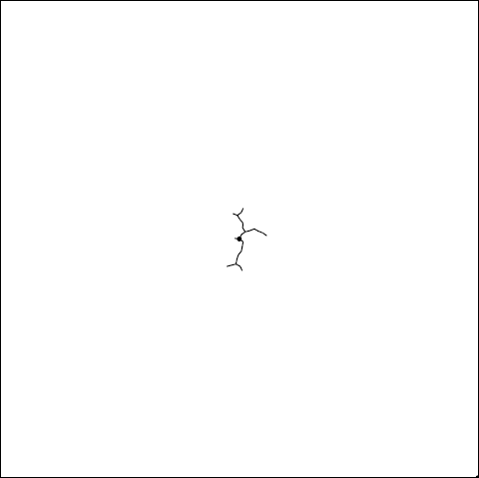
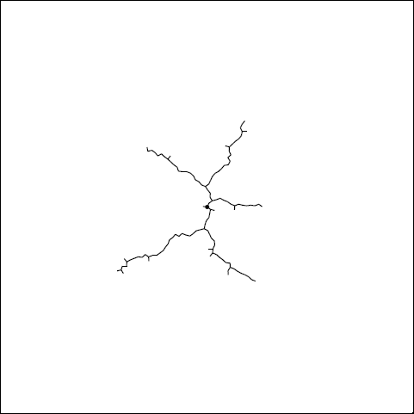
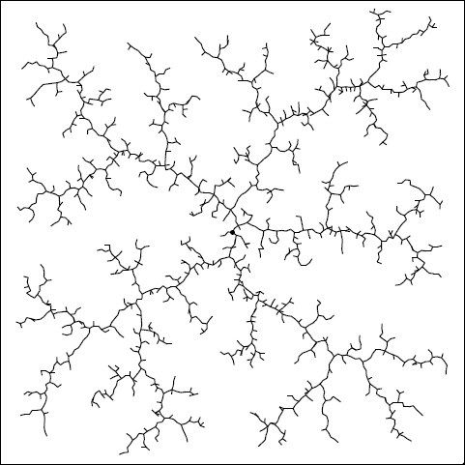
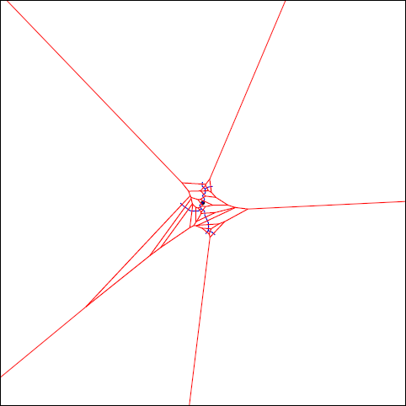
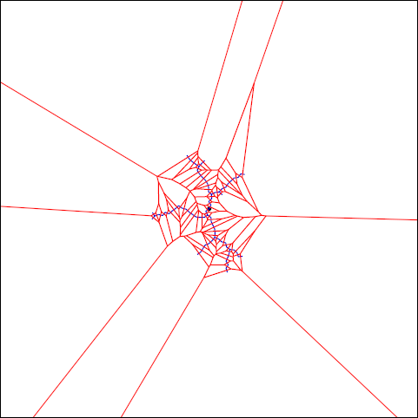
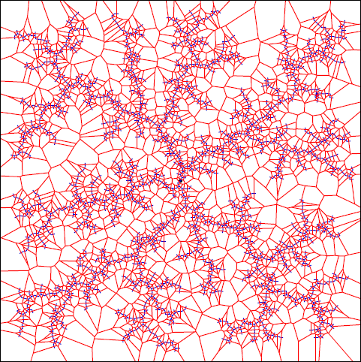
Rapidly exploring random trees Original
Notes:
Another very nice example of the use of DP are Rapidly exploring random trees
They use a randomized data structure that can be applyied onto many path planning problems
They start with the middle of the search space here viewed as white plane
They always look at the voronoi biases that are associated with the left space and pick a random sample in the left space
Than the nearest neighbor of the graph to that point is choosen and a action towards this point is selected which becomes an edge to that point
In the limit, the graph becomes infinite dense in the plane and all paths from and to any state can be calculated

Slide 27
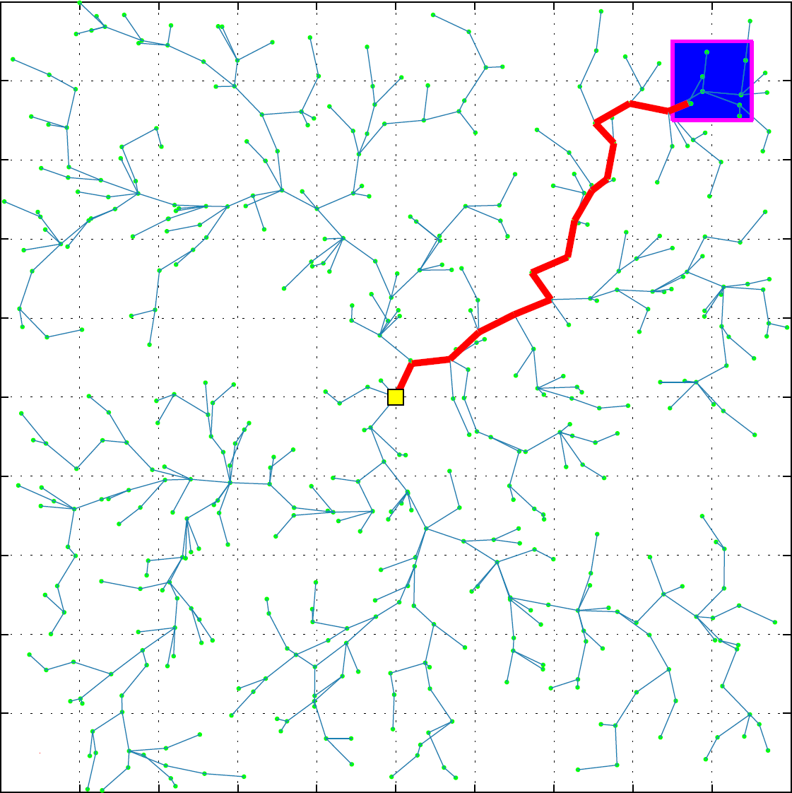
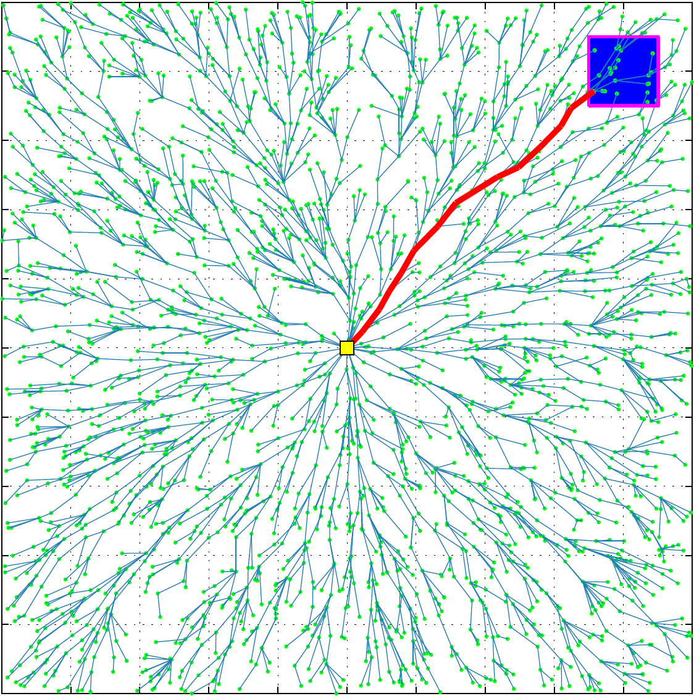
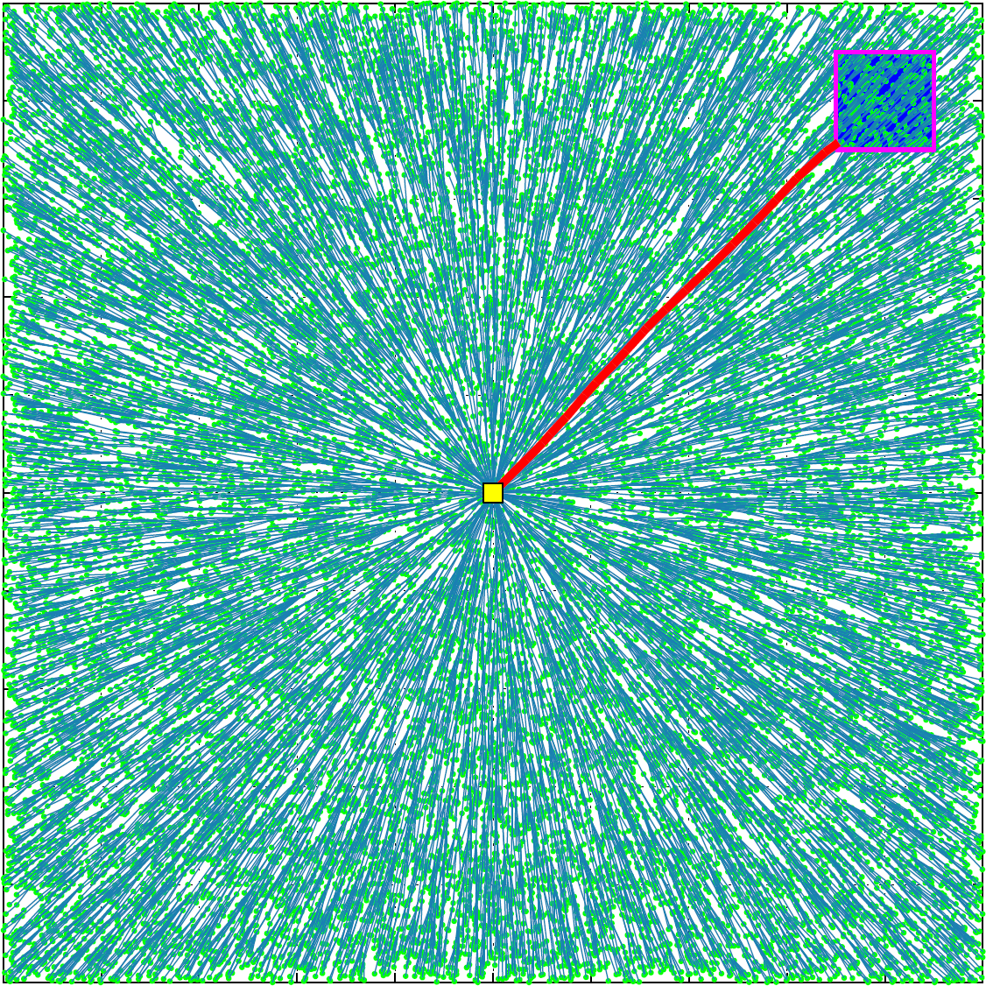
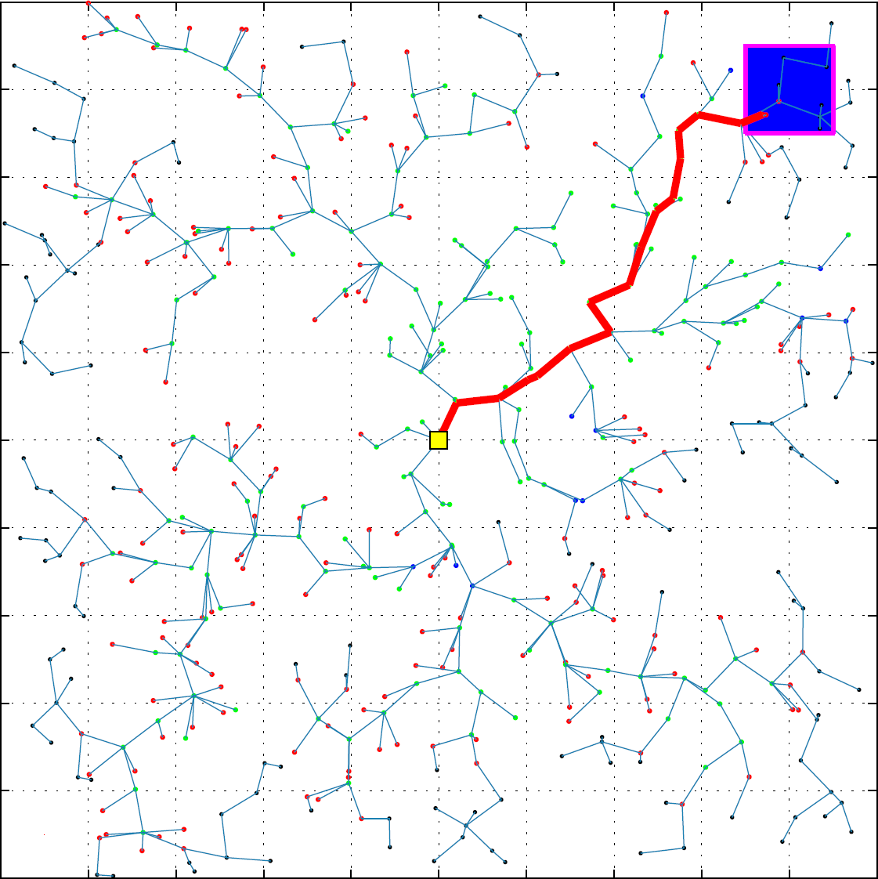
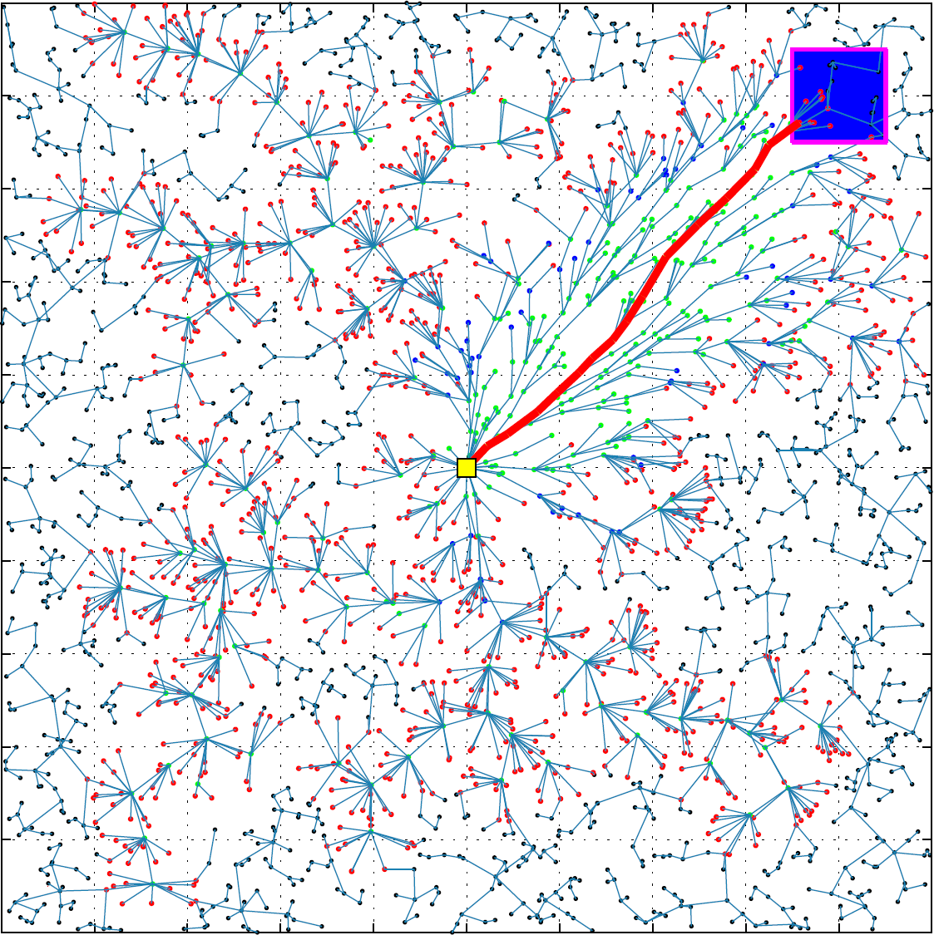
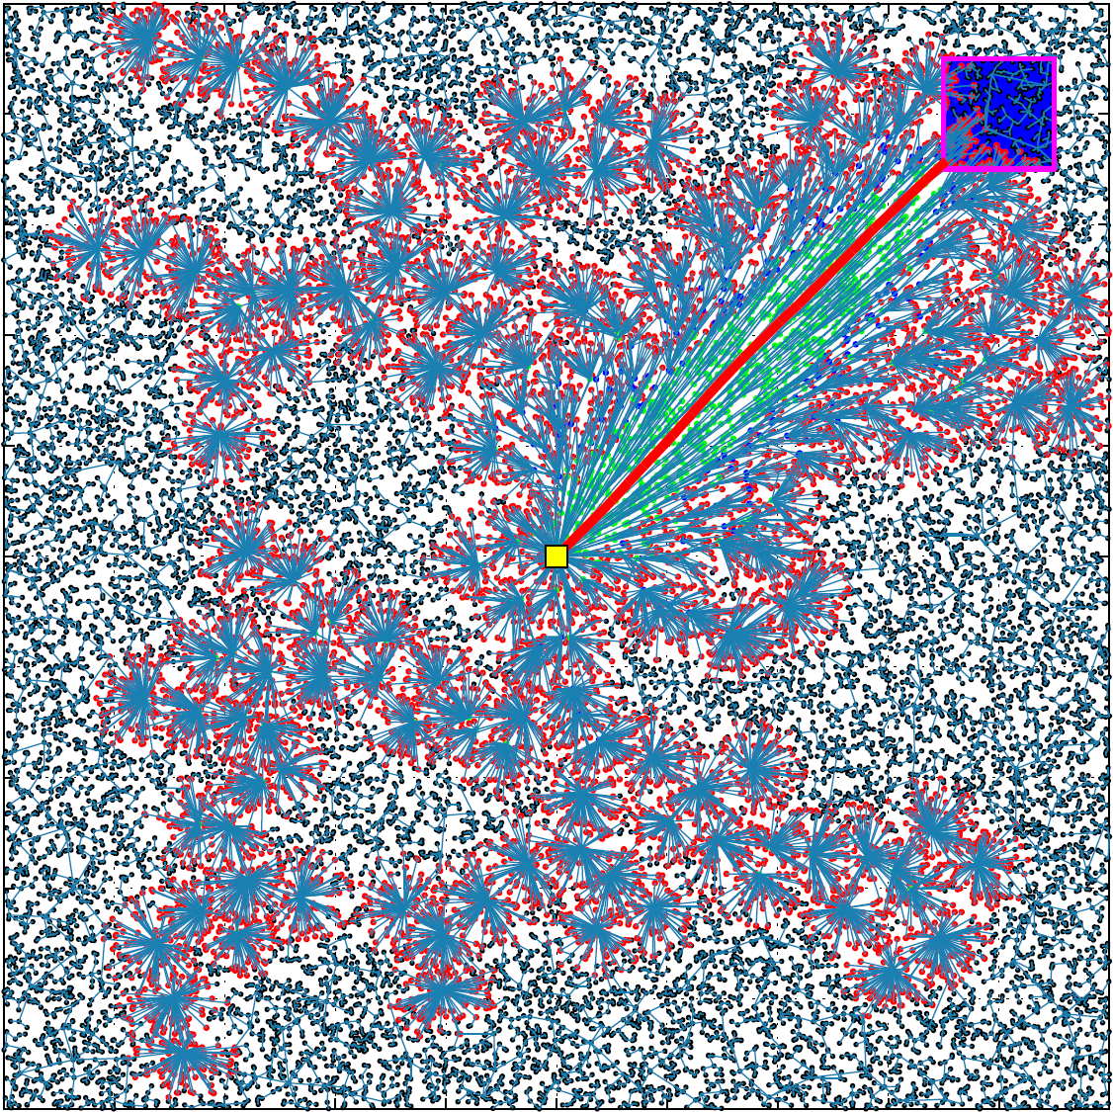
Rapidly exploring random trees Dynamic Programming
Notes:
Another very nice example of the use of DP are Rapidly exploring random trees
They start with the blank plane and span the tree step by step into the unexplored parts
In the limit, the graph becomes infinite dense in the plane and all paths from and to any state can be calculated
When using Dynamic Programming
Main idea is the same
But, by using DP the improved RRT algorithm calculates most promising neighbors
Normally calculation time is wasted due to uniform exploration in all directions
But with dynamic programming the improved algorithm calculates which nodes are most likely to lay on the path
These are only expanded and so calculation time is getting much less

Slide 28
Rapidly exploring random trees Dynamic Programming
Notes:
When using Dynamic Programming
Main idea is the same
But, by using DP the improved RRT algorithm calculates most promising neighbors
Normally calculation time is wasted due to uniform exploration in all directions
But with dynamic programming the improved algorithm calculates which nodes are most likely to lay on the path
These are only expanded and so calculation time is getting much less

Slide 29
Conclusion
Multistage decision problems can be solved by Dynamic Programming
It can be applyied onto many different types of problems
Especially for robot motion planning and path finding
Notes:
Dynamic Programming is a nice way to approach onto multistage decision problems
which can be applyied onto many different types of problems
Especially for robot motion planning and path finding it is very nice
And there is much research dedicated to it

Slide 30
Some more examples!
Notes:
Thank you for your attention
Are there questions?

